Slide 1
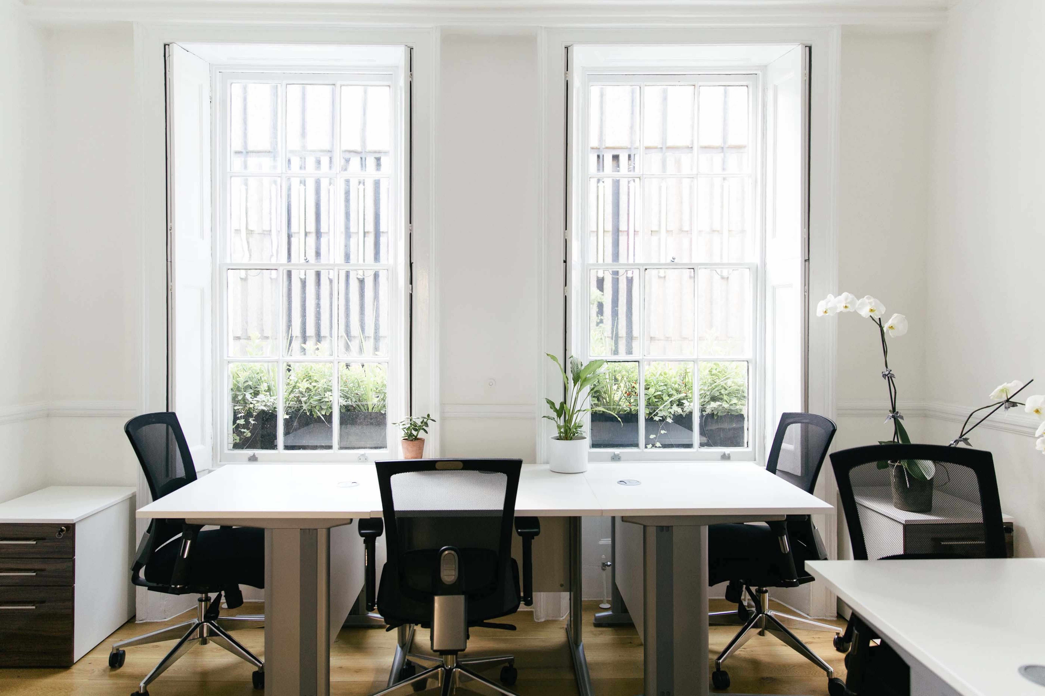
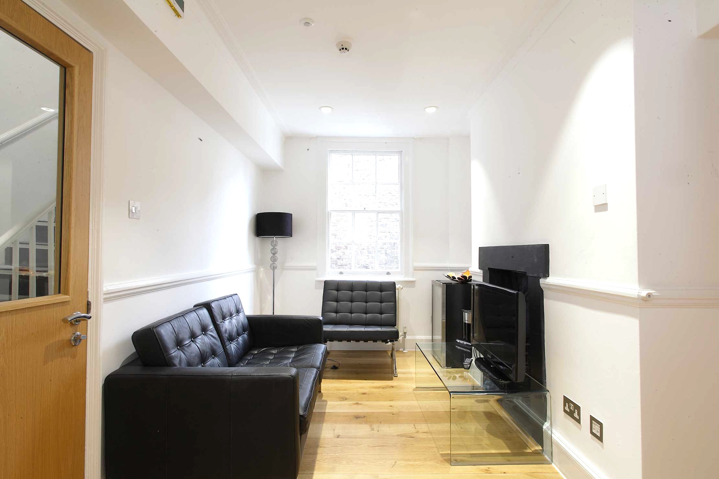
SOHO
Your own private office
All inclusive & flexible contracts
Building rates & all utilities
Fully furnished
Daily cleaning
In-house maintenance & IT support
Super-fast fibre internet
Dedicated private & secure connection
Meeting room
Kitchenette
Your own private
Ganton Street, W1
Managed Office

